Slide 1
Project 5
IMDB Movie Analysis
Chetan Vishwakarma
Onedrive Link : https://1drv.ms/x/s!AjQlE4wQ3A74gRTMgyyRKyBI54hv?e=MWAfR0

Slide 2
Some insights about the data:
The file consists of data which targets about the movies and the information related to movies.
It consists of information like directors name, actors and actress worked in the movie, details about the budget and gross income of the movie and IMBD score obtained for the movie.
Data contains many missing values in columns like color, director name, gross, budget and language.
Data needs to be cleaned like missing data treatment, outliers treatment by calculating the mean, median and mode values in all the columns.

Slide 3
Movie Genre Analysis: Analyze the distribution of movie genres and their impact on the IMDB score.
Task: Determine the most common genres of movies in the dataset. Then, for each genre, calculate descriptive statistics (mean, median, mode, range, variance, standard deviation) of the IMDB scores.
Approach: Firstly gathered the list of all the genre present in the data.
Then used COUNTIF Function for each genre to get the total number of movie of the separate genre.
Drama, Comedy and Thriller were the three topping the list.
Then calculated the Mean, Median, Mode,Min, Max, Range, Variance and Std. Variation of IMDB score for each genre of the movie.
It can be seen from the chart that Genres like HIstory, War, Biography and Noir are the genres which have the highest Imdb Ratings.
It is very obvious that Movies that represent Real time Scenarios Get much more Imdb scores than the other genres.

Slide 4
Formulas used for Extracting Following values:
ed in Extracting Following Values:
Count: =COUNTIF(Table1[genres],"*"&[@Genre]&"*")
Mean: =ROUND(AVERAGE(FILTER(Table1[imdb_score],ISNUMBER(SEARCH([@Genre],Table1[genres])))),3)
Median: =MEDIAN(FILTER(Table1[imdb_score],ISNUMBER(SEARCH([@Genre],Table1[genres]))))
Mode: =MODE(FILTER(Table1[imdb_score],ISNUMBER(SEARCH([@Genre],Table1[genres]))))
Min: =MIN(FILTER(Table1[imdb_score],ISNUMBER(SEARCH([@Genre],Table1[genres]))))
Max: =MAX(FILTER(Table1[imdb_score],ISNUMBER(SEARCH([@Genre],Table1[genres]))))
Variance: =ROUND(VAR(FILTER(Table1[imdb_score],ISNUMBER(SEARCH([@Genre],Table1[genres])))),3)
Std. Deviation: =ROUND(STDEV(FILTER(Table1[imdb_score],ISNUMBER(SEARCH([@Genre],Table1[genres])))),3)
Range: =([@Max]-[@Min])
#Div/0! = Not divisible by zero
#N/A = No value available

Slide 5
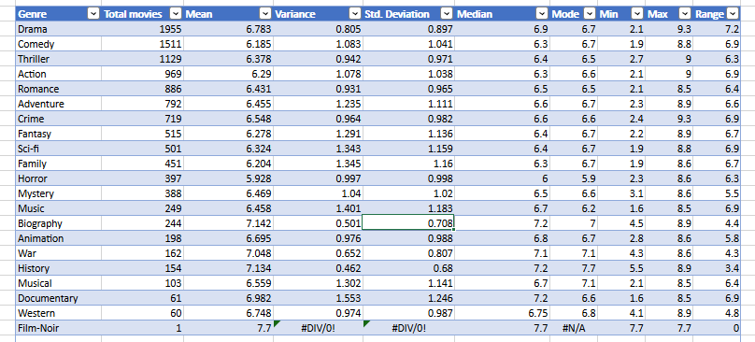
Sheet Name: Genres analysis

Slide 6
Movie Duration Analysis: Analyze the distribution of movie durations and its impact on the IMDB score.
Task: Analyze the distribution of movie durations and identify the relationship between movie duration and IMDB score.
Approach: Firstly, taken the count, Mean, median and standard deviation of the Movie duration column.
Prepared a histogram chart showing the count of the movies with respect to the duration of the movies.
From the chart it can be seen that movies having the duration from 94 to 104 minutes are the maximum and the data provided is left skewed.
Then created a scatter plot chart, showing the points of duration with respect to the IMDB score obtained.
The scatter plot shows a positive trendline in the graph and from the data it can be seen that it the movies with higher duration have much more IMDB score than the movies with less duration.

Slide 7
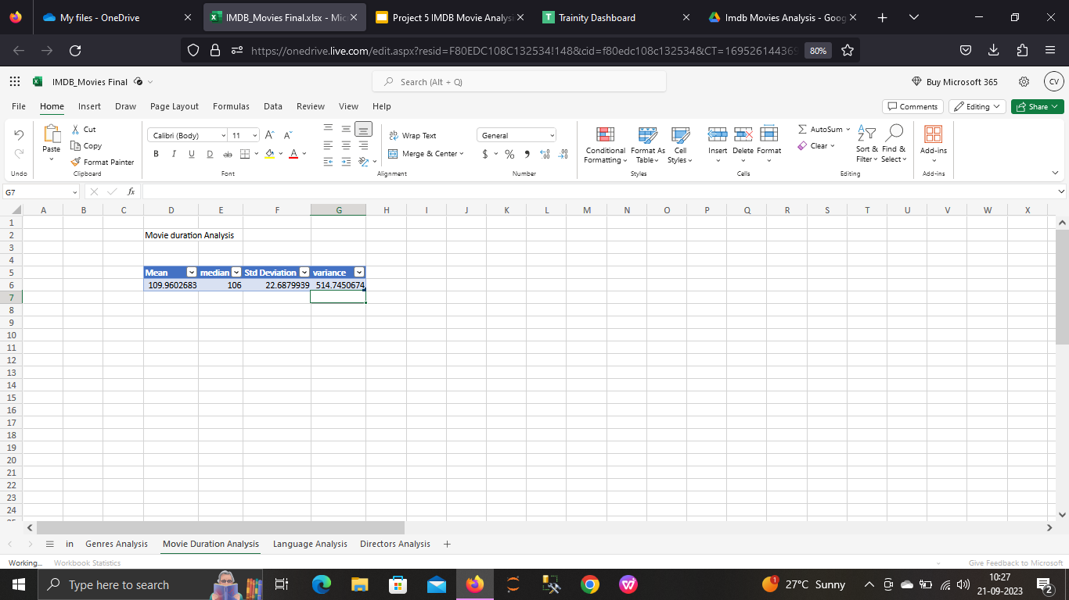
Formulas used for Extracting Following values:
Sheet Name: Movie Duration Analysis
Mean: =AVERAGE(Table1[duration])
Median: =MEDIAN(Table1[duration])
Std. Deviation: =STDEV.P(Table1[duration])
Variance: =VAR.P(Table1[duration])

Slide 8
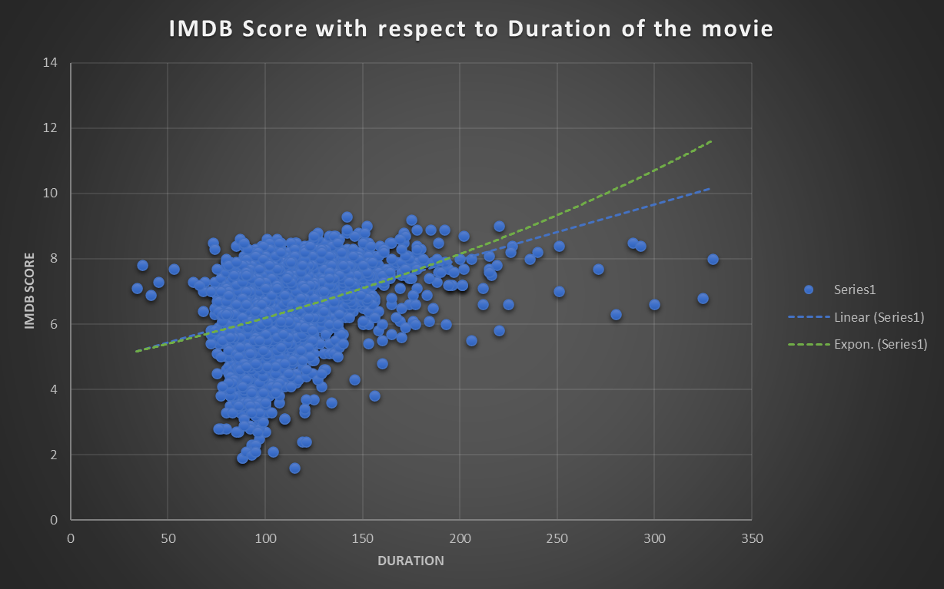

Slide 9
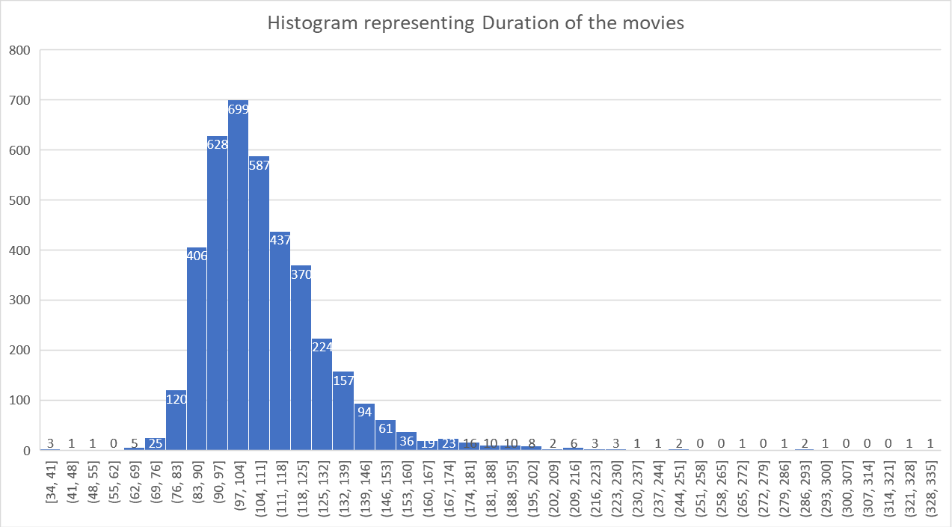

Slide 10
Language Analysis: Situation: Examine the distribution of movies based on their language.
Task: Determine the most common languages used in movies and analyze their impact on the IMDB score using descriptive statistics.
Approach: Firstly, Using UNIQUE function, we retrieve the languages present in the data. Then using COUNTIF function we obtain the total amount of movie with respect to the language of the movie.
English movies are the most present in the data followed by french and spanish movies.
Then calculated the Mean, Median, Mode and standard deviation of imdb score for each language.
From the chart it can be obtained that Persian and telugu movies have highest IMDB scores followed by danish, Indonesian and Romanian movies.
Mean of IMDB scores of these languages is high because of the least count of movies present in the data

Slide 11
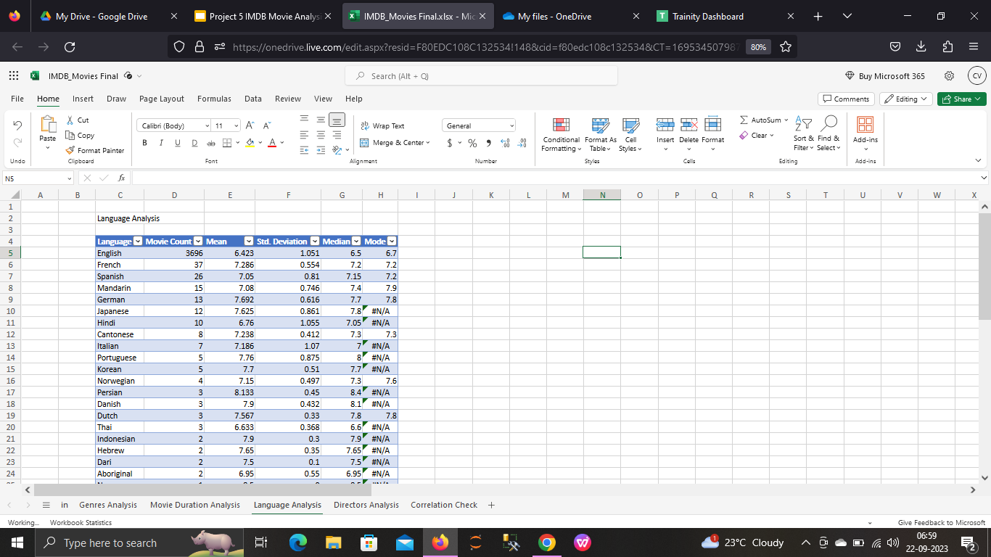
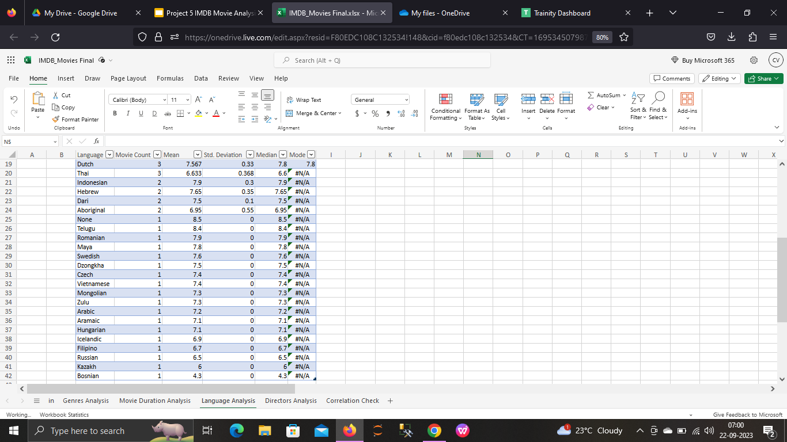
Sheet Name: Language Analysis

Slide 12
Formulas used for Extracting Following values:
Count: =COUNTIF(Table1[language],[@Language])
Mean: =ROUND(AVERAGEIF(Table1[language],[@Language],Table1[imdb_score]),3)
Median: =MEDIAN(IF(Table1[language]= [@Language],Table1[imdb_score]))
Mode: =MODE(IF(Table1[language]=[@Language],Table1[imdb_score]))
Std. Deviation: =ROUND(STDEV.P(IF(Table1[language]=[@Language],Table1[imdb_score])),3)

Slide 13
Director Analysis: Influence of directors on movie ratings.
Task: Identify the top directors based on their average IMDB score and analyze their contribution to the success of movies using percentile calculations.
Approach: Firstly to obtain the list of name of directors, we use unique value function.
Then we use COUNTIF function on all Directors individually to retrieve the total number of movies directed.
Then for obtaining the average IMDB score we use AVERAGEIF function for all the directors.
After obtaining Average values, we extract 25th, 50th, 75th and 100th percentile values.
Directors like Tony Kaye, Charles Chaplin, Alfred HItchcock , Ron Fricke, Damien Chazelle and many more have an average IMDB score of above 8 but since only single record is provided in the data hence it can be considered as an outlier.
Directors like Christopher Nolan, Quentin Tarantino and James Cameron having 8,8 and 7 records have Imdb scores above 8 can be considered in observation.

Slide 14
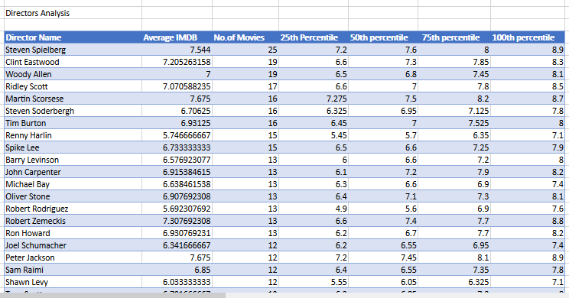
Chart Showing List of Directors sorted with respect to no. of movies directed:

Slide 15
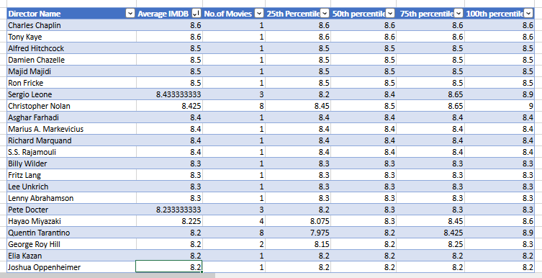
Chart Showing List of Directors sorted with respect to Imdb Rating on movies Obtained:

Slide 16
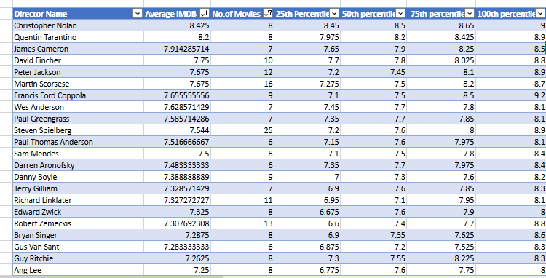
Chart showing List of directors with respect to Imdb after removing outliers:

Slide 17
Formulas used for Extracting Following values:
Average Imdb: =AVERAGEIF(Table1[Director Name],[@[Director Name]],Table1[imdb_score])
Count of movies: =COUNTIF(Table1[Director Name],[@[Director Name]])
25th percentile: =PERCENTILE(IF(Table1[Director Name] = [@[Director Name]],Table1[imdb_score]),0.25)
50th percentile: =PERCENTILE(IF(Table1[Director Name] = [@[Director Name]],Table1[imdb_score]),0.50)
75th percentile: =PERCENTILE(IF(Table1[Director Name] = [@[Director Name]],Table1[imdb_score]),0.75)
100th percentile: =PERCENTILE(IF(Table1[Director Name] = [@[Director Name]],Table1[imdb_score]),1)

Slide 18
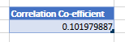
Budget Analysis: Explore the relationship between movie budgets and their financial success.
Task: Analyze the correlation between movie budgets and gross earnings, and identify the movies with the highest profit margin.
Approach: To obtain the profit obtained by each movie, we create a new column in the data naming Profit we obtain the data in this column by subtracting movie budget and gross earnings.
To obtain the correlation between the two columns i.e movie budget and gross earnings, we use CORREL function.
From the formula, we obtain a value of 0.10197 as correlation coefficient which cleary stats that the two columns are very weakly correlated in the positive side.
Below are the tables of movie who have Earned a maximum amount of profit and the other shows the list of movie who have beared a maximum amount of losses.
Correlation Coefficient: =CORREL(Table1[budget],Table1[gross])
Sheet Name: Correlation Check

Slide 19
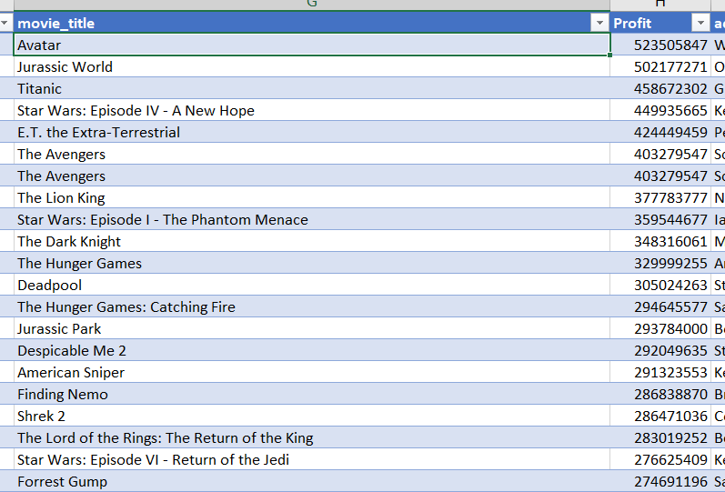
Corrl -0.10198

Slide 20
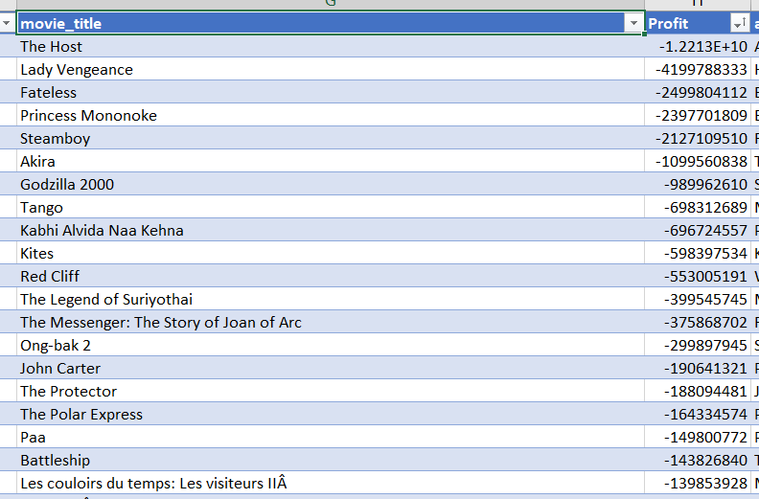

Slide 21
Report and Result :
Data mainly consist of movies that are of English Language and from USA.
Real Time themed movies of genres like History, War, biography and Documentary have higher IMDB ratings as compared to other genres like Drama, comedy, Animation etc
IMDB scores mainly depends on the story, cast of the film, way of direction and screenplay.
With good IMDB scores it can be seen that there is a good profit margin in the movies.
From the project got to learn about different functions like countif, averageif, Median, Mode, std deviation , variance and correl.
Got deep knowledge in preparing charts in the excel workbook.
Got to practice with huge dataset, and handling the data in the excel workbook.

